Slide 1
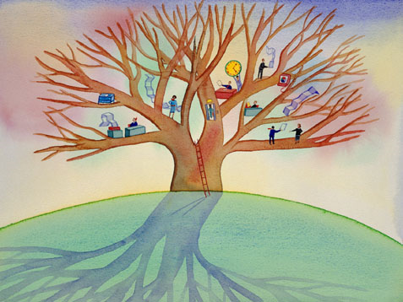
Welcome to the Ethics Seminar

Slide 2
SHARED CODE OF ETHICS AND VALUES
OF THE COMMUNITIES OF
Counties: Lake, LaPorte, Porter
Cities: Crown Point, East Chicago, Gary, Hobart,
Portage, Valparaiso, Whiting
Towns: Burns Harbor, Cedar Lake, Chesterton,
Dyer, Hebron, Highland, Lake Station, Lowell, Merrillville, Munster, Ogden
Dunes, Schererville, St John, Westville

Slide 3
CODE OF SHARED ETHICS AND VALUES

Slide 4
PREAMBLE
For government to operate with transparency and accountability it is essential that public officials and employees conduct themselves in ways that uphold the public trust. The Shared Code of Ethics and Values provides guidance and support to public servants for the promotions and maintenance of the highest standards of personal and professional conduct. Because we wish to ensure the public confidence in the integrity of out government entities, it is proposed that all elected and appointed officials, employees, volunteers, and others who participate in government shall personally commit to being trained on the values and standards put forth in this document.

Slide 5
Our Values: Honesty/Integrity
To exercise the moral courage to hold myself and others accountable for our actions
To work within the law and in a way that will bear close public scrutiny
To exhibit trustworthiness
To employ decision making that promotes the public’s best interest
To avoid impropriety and refrain from misusing an official position to secure unwarranted privileges or advantages for myself or others
To make no private promises of any kind that may unduly influence my public duties
To refrain from engaging in business that would be directly or indirectly inconsistent with the conscientious performance of public duties
To accept the responsibility to expose corrupt and/or unethical behavior
To protect the public trust my exercising honesty and ensuring transparency

Slide 6
Our Values: Respect/Civility
To treat every person with dignity and respect
To accomplish the goals and responsibilities of my individual position while respecting my role as a member of a team and the community at large
To act in a professional, responsive and courteous manner
To reach decisions only after considering various points of view
To work with others in a spirit of tolerance and understanding
To work to build consensus and accommodate diverse opinions
To utilize effective communication by listening, asking questions and responding in a way that adds value to the conversation
To support the public’s right to know the truth and encourage diverse and civil public debate in the decision-making process

Slide 7
Our Values: Accountability/Responsibility
To refrain from using official positions to secure unwarranted privileges or advantages for myself or others
To remove myself from every decision-making process in which I, my business, my associates or my family may benefit and upon removing myself form decisions, I will show self-restraint and not voice my opinion on the question
To conduct my private affairs in a manner that minimizes the risk of real, potential or perceived conflicts of interest
To make full public disclosure of the nature of any conflict of interest prior to any considered action
To respect the privacy of others by keeping confidential information that I acquire in the course of my professional duties protected unless a legitimate reason to disclose exists
To refrain form taking advantage of information received in the course of my professional duties that is not available to the public
To refrain from directly or indirectly using or allowing the use of government property for anything other than official activities
To refrain from soliciting or accepting gifts or gratuities that may have a real or perceived influence on my objectivity in carrying out official responsibilities or placing me under obligation to the donor
To refrain from competing with the community where I am employed or serve as an appointed or elected official

Slide 8
Our Values: Fairness/Justice
To advocate and promote the most efficient and effective way to deliver public services without prejudice or discrimination
To publicly acknowledge that the function of government is to serve the best interest of all citizens
To refrain from granting preferential treatment to family and friends when making staffing decisions or awarding contracts
To refrain from retaliation or condoning retaliation against those who have exposed corrupt of unethical behaviors
To assess the effects of inadequate resources on diverse groups within the service population and develop plans to remedy and implement such plans
To behave consistently and with respect toward all citizens

